Slide 1
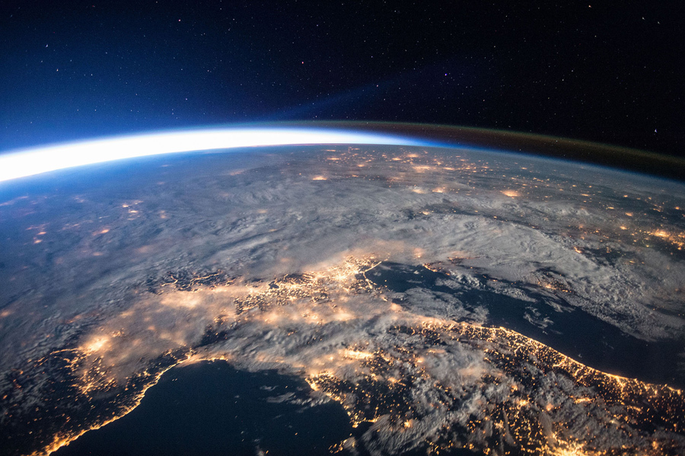
The Space Environment Lesson 4 – Plasma Part 2
The plasma environment:
Spacecraft Charging
Adapted from information in:
The Space Environment (TSE), by Tribble
Space Mission Analysis and Design (SMAD), Edited by Wertz and Larson
Notes:
5 key areas
Before moving into the details of designing space missions, it’s important to take a look at the constraints we’ll be operating under
Atmospheric neutrals – uncharged particles that cause drag and atomic oxygen effects
Expedition 47 from the ISS

Slide 2
Impact of the Space Environment on Spacecraft Systems
Space Environments
Vacuum | Neutral | Plasma | Radiation | MM/OD
Spacecraft Subsystems | Solar UV | Outgassing/ Contamination | Aerodynamic Drag | Sputtering | Atomic Oxygen | Spacecraft Glow | Spacecraft Charging | Van Allen Belts | Galactic Cosmic Rays | Solar Proton Events | Impacts
Attitude Determination & Control |  | Degradation of sensors | Induced torques |  |  | Interference with sensors | Torques due to induced potentials
Avionics |  |  |  |  |  |  | Upsets due to EMI from arcing |  |  |  | EMI due to impacts
Electrical Power |  |  |  |  |  |  | Shift in floating potential, reattraction of contaminants |  |  |  | Destruction/ obscuration of solar cells
Propulsion |  | Thruster plumes may be a contaminant source | Drag makeup fuel requirement |  |  |  | Shift in floating potential due to thruster firings |  |  |  | Rupture of pressurized tanks
Structures |  |  |  |  |  |  |  |  |  |  | Penetration
Telemetry, Tracking & Communications |  | Degradation of sensors |  |  |  | Interference with sensors | EMI due to arcing |  |  |  | EMI due to impacts
Thermal Control |  |  |  |  |  |  | Reattraction of comtaminants |  |  |  | Degradation of alpha/epsilon
Change in sensor coatings
Degradation: SEUs, bit errors, …
Change in coverslide transmittance
Change in coverslide transmittance
Degradation of solar cell output
Change in sensor coatings
Degradation of electronics
Change in surface alpha/epsilon ratio
Change in surface alpha/epsilon ratio
Cold surfaces may experience heating
TSE, Fig 7.1
Notes:
A variety of environmental effects have a direct impact on the ability of spacecraft subsystems to execute their design objectives
This chart provides a good summary of the impacts of the space environment on these subsystems
⇒ we’ll walk through each of these areas in the next several slides
Must recognize that extra margin must be designed into spacecraft subsystems to handle these impacts

Slide 3
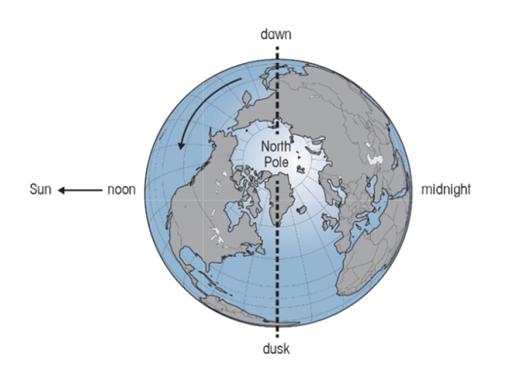
The Plasma Environment and Potential Effects
Charged particles – electrons and ions with energies between 5 and 50 keV
Magnetic storms that dissipate stored magnetic energy in the Earth’s magnetotail are the primary source of this energized plasma
A high-velocity spacecraft moving through the plasma causes charging of the spacecraft’s surfaces to high potentials
In LEO, the differential charging that can be detrimental to vehicle operation occurs only at high latitudes
In GEO, surface charging occurs during magnetic substorms between longitudes corresponding to midnight and dawn
Notes:
“gas” of electrically charged particles with kinetic energy greater than the potential energy of attraction
(absolute value is rarely of concern)
Closely spaced surfaces create equilibrium by forming a current path
EMI is a problem for sensitive electronics
Effects are similar to the neutral environment
Outgassed materials ionized by solar UV are reattracted to the negatively charged spacecraft (particularly significant in GEO orbits)
In physics, the electronvolt^{[1][2]} (symbol eV, also written electron-volt and electron volt) is a unit of energy equal to approximately 1.6×10⁻¹⁹ joules (symbol J). By definition, it is the amount of energy gained (or lost) by the charge of a single electron moving across an electric potential difference of one volt. Thus it is 1 volt (1 joule per coulomb, 1 J/C) multiplied by the elementary charge (e, or 1.6021766208(98)×10⁻¹⁹ C^{[3]}). Therefore, one electronvolt is equal to 1.6021766208(98)×10⁻¹⁹ J.^{[4]}

Slide 4



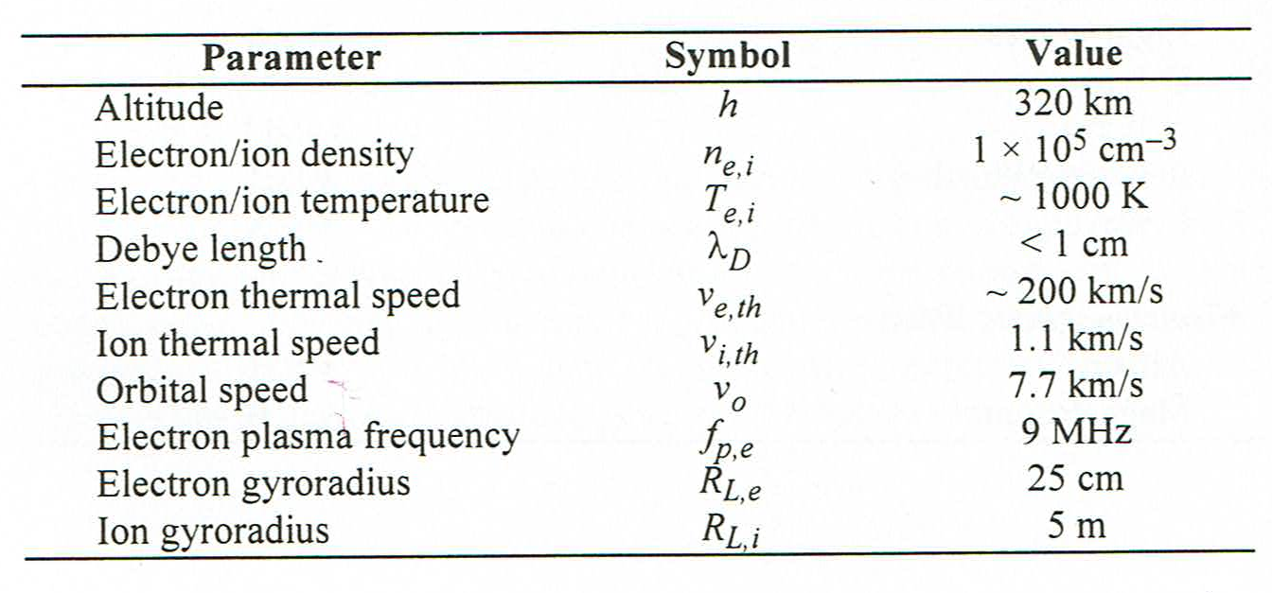
Spacecraft charging ionosphere plasma characteristics

Slide 5
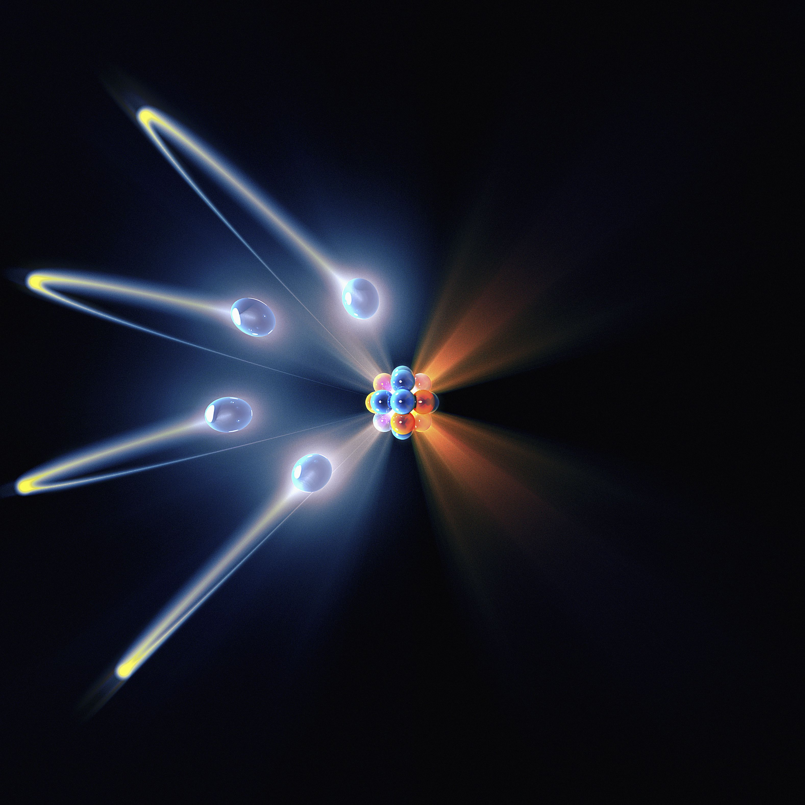
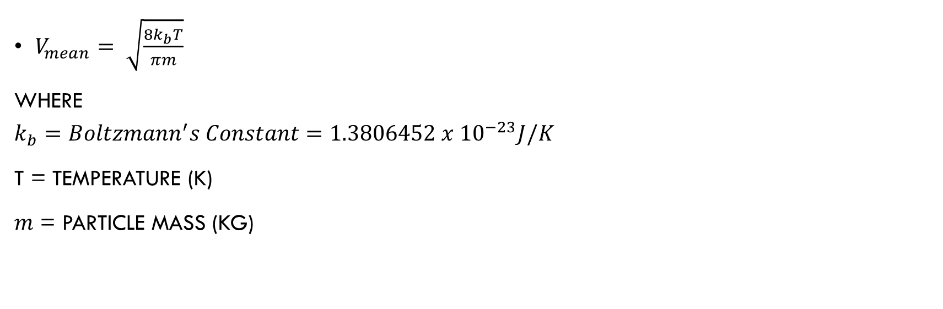
Mean or average speed of electrons and protons
$V_{mean}= \sqrt{\frac{8k_{b}T}{πm}}$
Where
$$k_{b}=Boltzmann^{′}s Constant=1.3806452 x {10}^{−23}J/K$$
T = Temperature (k)
$m$ = particle mass (kg)

Slide 6
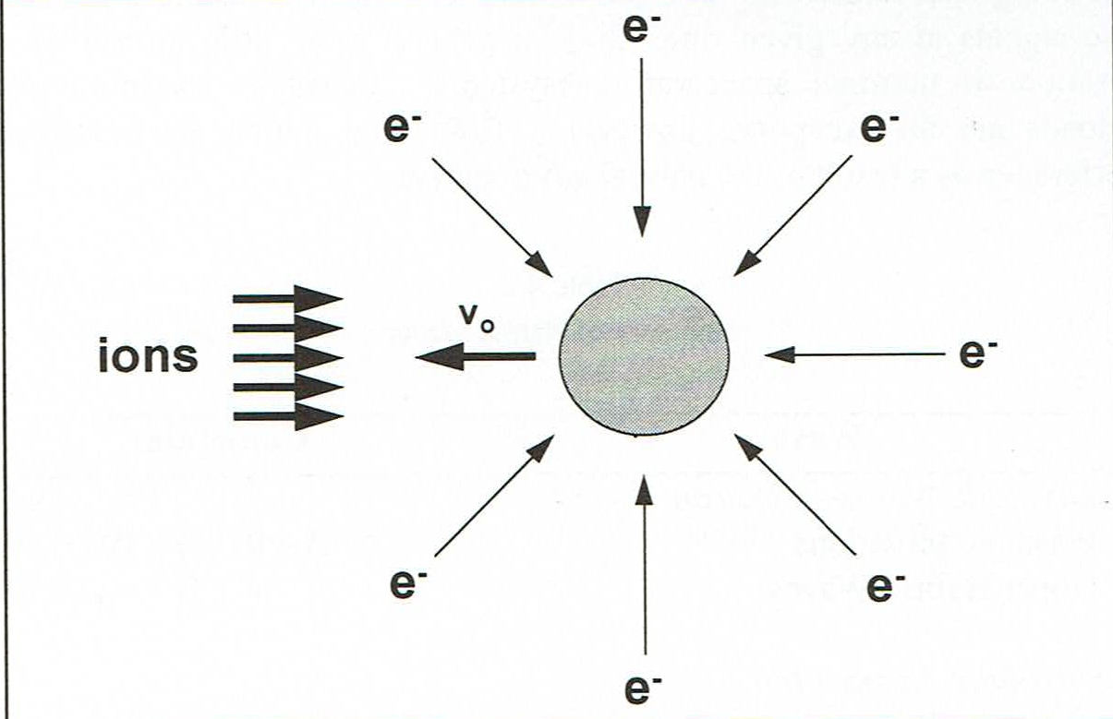
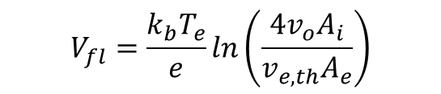


Floating potential
$$V_{fl}=\frac{k_{b}T_{e}}{e}ln\left(\frac{4v_{o}A_{i}}{v_{e,th}A_{e}}\right)$$
Where:
$V_{fl}$ = floating potential (volts)
$$k_{b}=Boltzmann^{′}s Constant=1.3806452 x {10}^{−23}J/K$$
$e$ = charge (electron = 1.6 x ${10}^{−19}C$)
$v_{o}$ = orbital speed (km/s)
$A_{i}$ = area of spacecraft collecting ions
$v_{e,th}$= electron thermal speed
$A_{e}$ = area of spacecraft collecting electrons

Slide 7
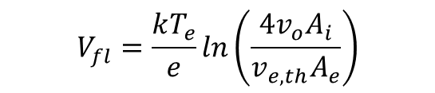
example
Calculate the approximate floating potential for a spherical conducting object in a 300 km circular orbit under average solar cycle conditions
$$V_{fl}=\frac{kT_{e}}{e}ln\left(\frac{4v_{o}A_{i}}{v_{e,th}A_{e}}\right)$$

Slide 8
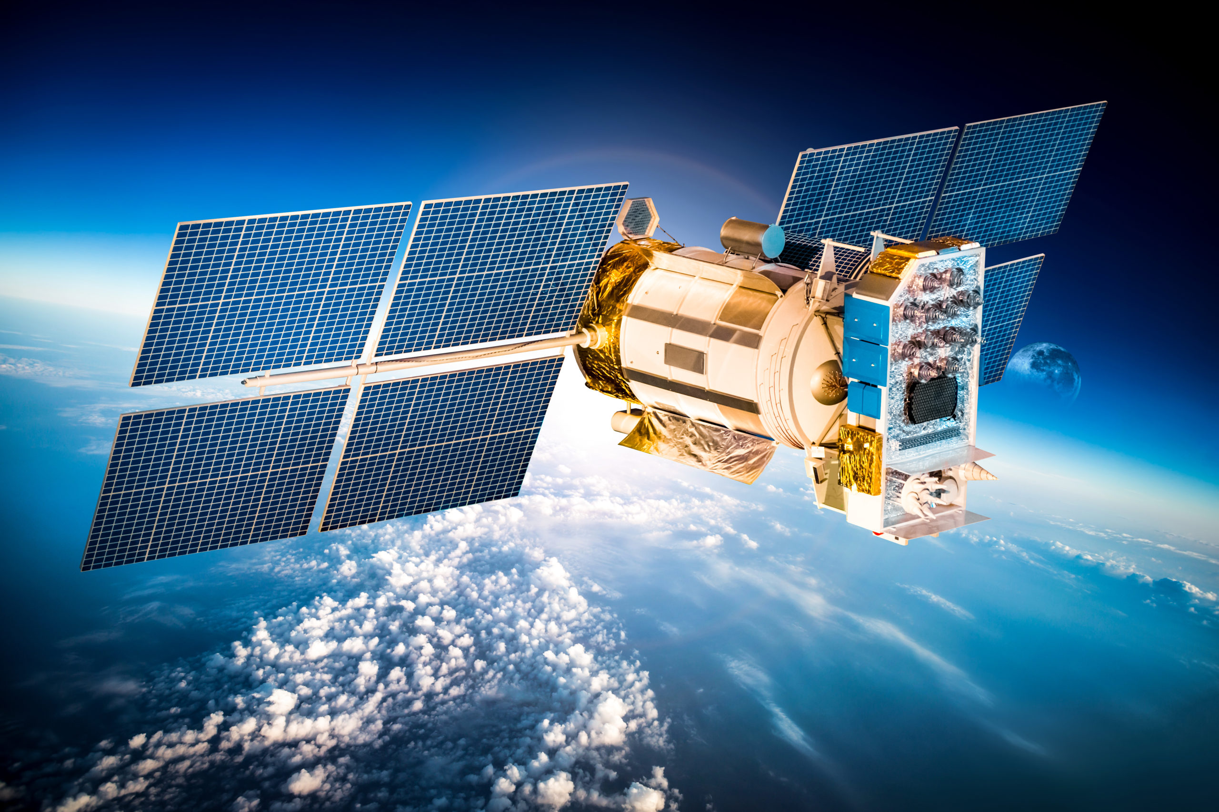
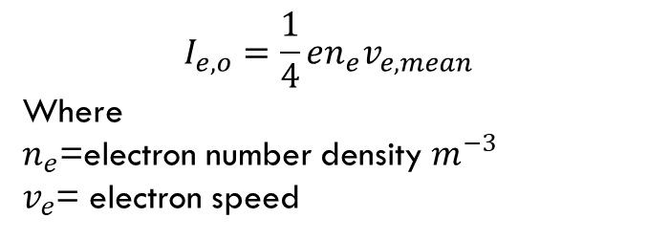

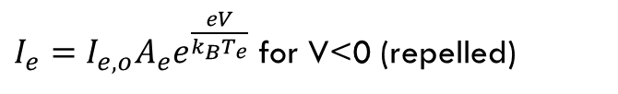

Biased object?
$I_{e}=I_{e,o}A_{e}e^{\frac{eV}{k_{B}T_{e}}}$ for V<0 (repelled)
$I_{e}=I_{e,o}A_{e}\left[1+\frac{eV}{k_{B}T_{e}}\right]$ for V>0 (attracted)
$$where$$
$I_{e,o}$ = current density /m-3
V = bias voltage
$e$ = charge (C)
$$k_{b}=Boltzmann^{′}s Constant$$
$=1.3806452 x {10}^{−23}J/K$
$T_{e}$ = electron temperature (K)
$$I_{e,o}=\frac{1}{4}en_{e}v_{e, mean}$$
Where
$n_{e}$=electron number density $m^{−3}$
$v_{e}$= electron speed

Slide 9
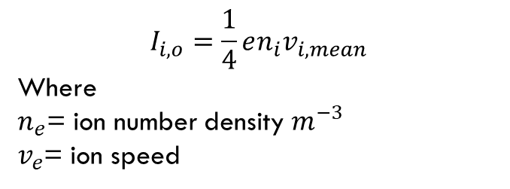

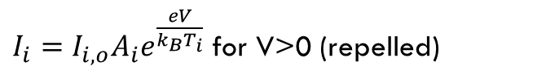

Biased object?
$I_{i}=I_{i,o}A_{i}e^{\frac{eV}{k_{B}T_{i}}}$ for V>0 (repelled)
$I_{i}=I_{i,o}A_{i}\left[1+\frac{eV}{k_{B}T_{i}}\right]$ for V<0 (attracted)
$$where$$
$I_{i,o}$ = current density$m^{−3}$
V = value of bias voltage
$e$ = charge (C)
$$k_{b}=Boltzmann^{′}s Constant$$
$=1.3806452 x {10}^{−23}J/K$
$T_{i}$ = ion temperature (K)
$$I_{i,o}=\frac{1}{4}en_{i}v_{i, mean}$$
Where
$n_{e}$= ion number density $m^{−3}$
$v_{e}$= ion speed

Slide 10
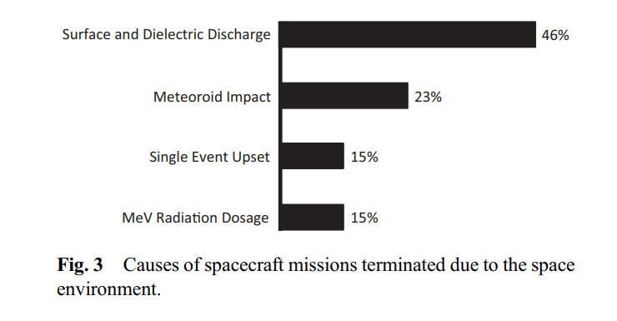
CHARGING TERMINOLOGY
ABSOLUTE – SPACECRAFT AS A WHOLE ACCUMULATES A NET CHARGE
DIFFERENTIAL – DIFFERENT PORTIONS OF SPACECRAFT CHARGE TO DIFFERENT POTENTIALS
INTERNAL – HIGH ENERGY PARTICLES > 100 KEV
SURFACE CHARGING – NEARBY SURFACES ARE CHARGED DIFFERENTIALLY

Slide 11
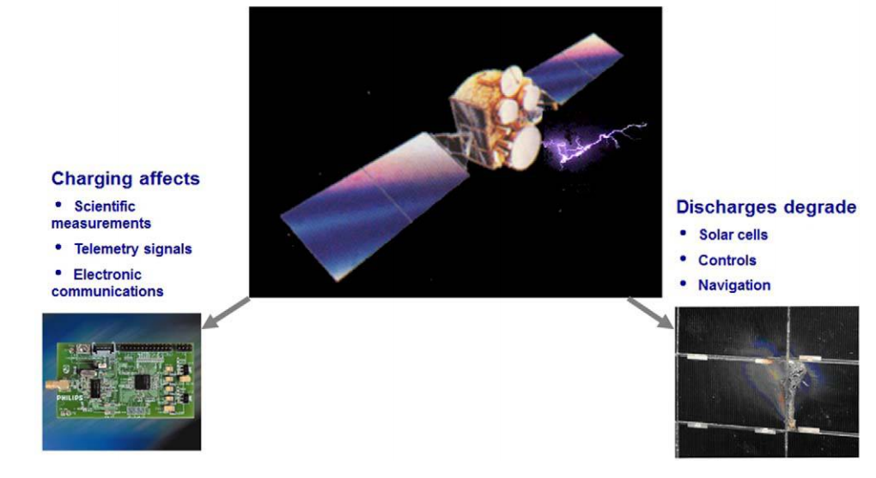
SPACECRAFT CHARGING

Slide 12
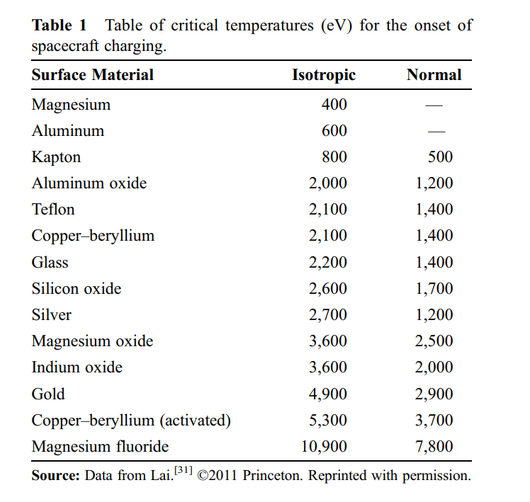
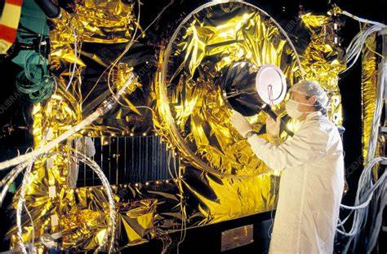
THERMAL ENERGIES for the onset of charging

Slide 13
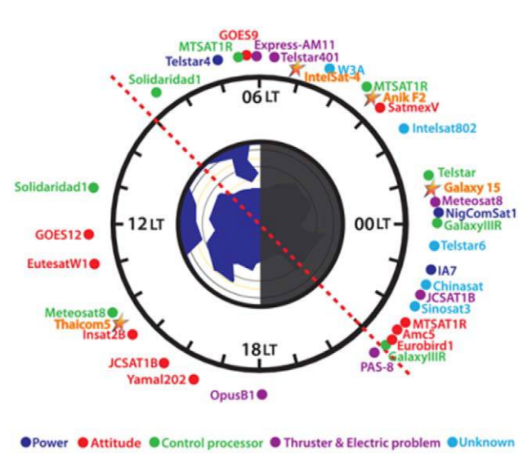
Local time occurrences of spacecraft anomalies

Slide 14
The Plasma Environment and Potential Effects
Problems include
Arcing (the dominant concern)
Electrostatic Discharge (point-to-point arcing) – caused by large potential differences between conductors and dielectrics
Dielectric Breakdown (arcing through a material) – caused by large potential differences through surfaces
Generates electromagnetic interference (EMI) and damages surfaces (damage to solar arrays and electronics of greatest concern)
Increased currents: may alter floating potential or drain available power
Ion drag: may add to orbit decay
Ion sputtering: may increase erosion of surfaces
Re-attraction of contamination: may be significant in degrading surfaces
Notes:
“gas” of electrically charged particles with kinetic energy greater than the potential energy of attraction
(absolute value is rarely of concern)
Closely spaced surfaces create equilibrium by forming a current path
EMI is a problem for sensitive electronics
Effects are similar to the neutral environment
Outgassed materials ionized by solar UV are reattracted to the negatively charged spacecraft (particularly significant in GEO orbits)

Slide 15
Summary of Environment Effects
Notes:
To summarize, here are the environmental effects you have to consider as you investigate spacecraft orbits

Slide 16
REFERENCES
Lai, Shu T. and K. Cahoy. (2017, Feb) Spacecraft Charging.

